Slide 1

Don't Panic! A Guide to Proactive Security for SMB
Clarissa Bury
Ryan St. Germain

Slide 2
Introductions
Ryan St. Germain
Principal Consultant, Strategic Advisory Services
Previously Manager of Security and Infrastructure
15 years in the IS industry
Clarissa Bury
Consultant, Strategic Advisory Services
Previously Security Engineer

Slide 3

This talk
What is proactive security?
Why is it important to SMB's?
What resources are available?
Documentation
Tools
Tabletops
Executive buy-in
Notes:
Adapt proactive security practices we see at large companies to SMBs
Proactive sec always has its challenges
Big companies have more to work with
SMBs don’t
Have to be more precise with their resources
Can mean proactive sec isn’t prioritized
Proactive security
Everything you do before an attack
Preemptively finding and addressing weaknesses
Important bc makes orgs resilient
Prevent attacks and better prepare

Slide 4
Playbooks/Runbooks
Common and repeatable
Treated as living documents
Paves a path towards automation
Notes:
Playbooks/Runbooks
- One theme in our assessments is the lack of documentation. Specifically the absence or neglection of runbooks and playbooks. This is a problem in small the large fortune 500 companies. This is not a money problem.
More people tend to share hats and responsibilities.
Playbooks are top-level objectives or subjects like a phishing attack
Runbooks are the actual procedures you take to address the subject, such as blocking an ip address
Take the form of procedures – So instructions and steps to accomplish an action
Need to be treated like living documents. Changes with the org and technology
Leveraged for automation

Slide 5


Slide 6
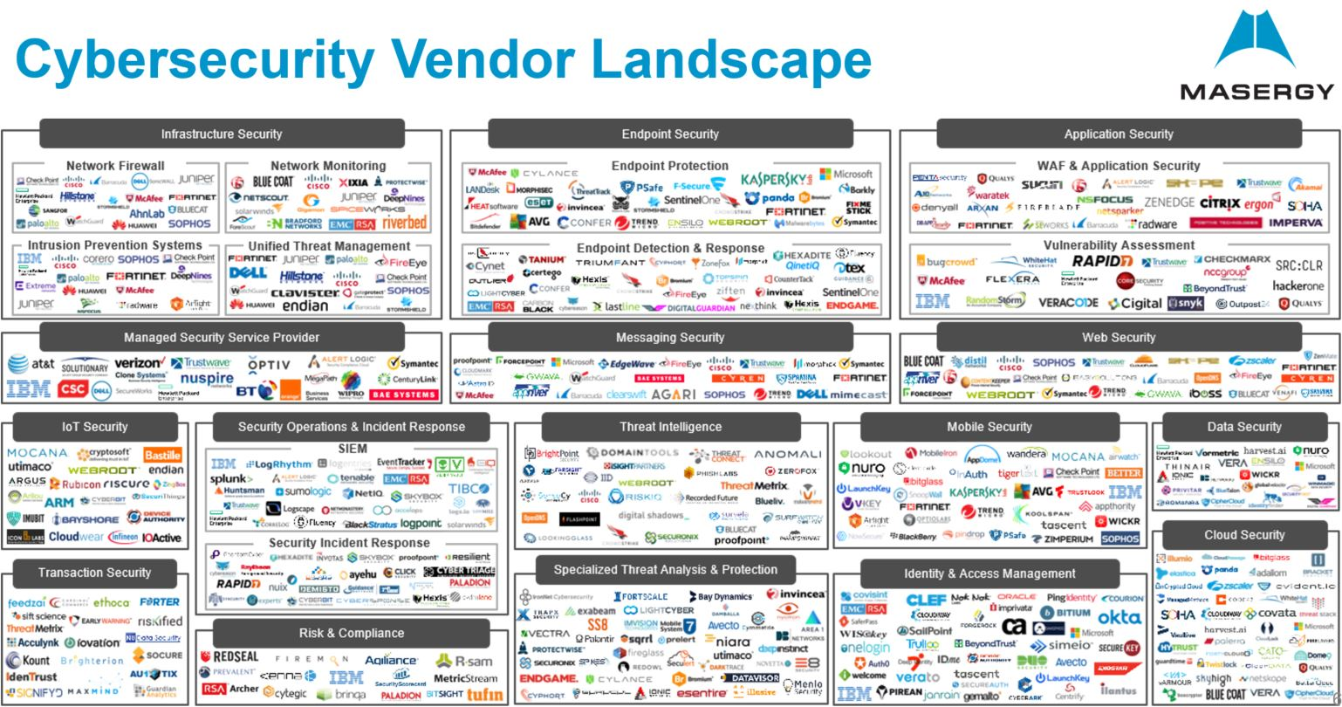
Notes:
We are bombarded by vendors and top 50 lists. How are we supposed to understand what we need as an organization.
Need the people to manage the technology

Slide 7
Defense in-depth
Visibility
Prevention
Configuration Management
Ticketing & Case Management
Notes:
Name of the game is defense in-depth not "buy all the things". If the strategy is to buy security, you have already failed.
Try to get the most out of what you have
Identify free solutions to advance the security program
If you gave me budget to pick my first control, it would be a SIEM, which you can build your other controls around
Send all of your logs to gain visibility within your environment, including routers, servers, printers, you name it
Configuration management isn’t as sexy but it is just as important
You want to harden what you are protecting
This means leveraging hardened images and baseline images that follow standards such as CIS or STIG
Ticket and case management will allow you to collect and track alerts and incidents – You need a hub to collect this information – A shared email account should be not be used
So lets talk about free solutions to help you achieve this goal

Slide 8
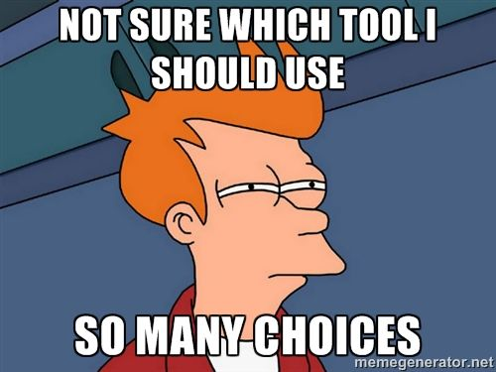
"Free solutions"
Stenographer
Suricata
ELK Stack
Sysmon
OpenCTI
TheHive Project
Sublime Security
….... The list goes on
Notes:
"Free" doesn’t means there isnt any financial cost

Slide 9
"Free" solution considerations
Actively supported
Cost of administration
System and security updates
Integrations with existing platforms
Notes:
Make sure its an actively supported project. You don’t want to implement a control and then have to tear it out
Time costs money. Free solutions don’t come with premium support included. Ensure the team managing the solution will be able to troubleshoot the solution.
Free solutions are sometimes deployed on virtual hardware or come packed in an ISO. Ensure the solution uses a supported OS release and will be supported for the next 3-5 years.
Pick a solution that will integrate with other products to help make your job easier and will scale for the future.

Slide 10

Case Management
TheHive Project
Incident tracking
Metrics
Integrations
Automation
Notes:
Need a place to centrally collect alerts and track incidents
Helps to replace email an email alias or a single point of failure if someone is out
Metrics are boring but help improve the program.
Example: Identifying log sources that are being utilized. Can help identify sources not being operationalized or that need to be removed to save money
Integrations and automation can help streamline IR processes. This solution is a great tool to help get you started.
Example: Enrichments of TTP and IOCs
https://www.strangebee.com/thehive

Slide 11
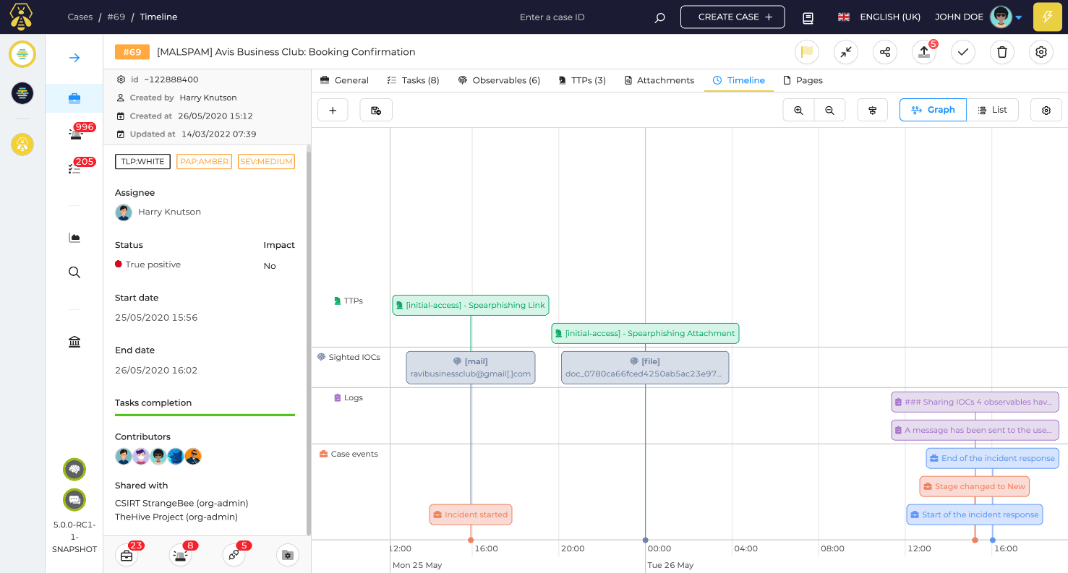
TheHive Project

Slide 12
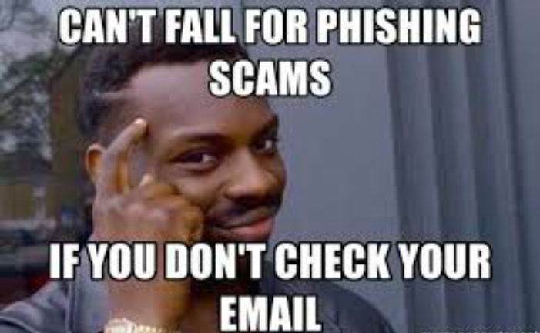
Email Security
Currently rely on vendor rules
SubIime Security
Message Query Language (MQL)
Message hunting
Native API integrations
Notes:
- Vendor solutions are closed door – No insight into Spam and phishing rules
Normally only have control over blocking an IP or sender address
Subliime gives you total control over rules and hunting using a message query language
Feels like writing SIEM rules
Natively integrates is MS and Google Workspace and even IMAP – No need to get it approved as an MTA
https://sublime.security

Slide 13
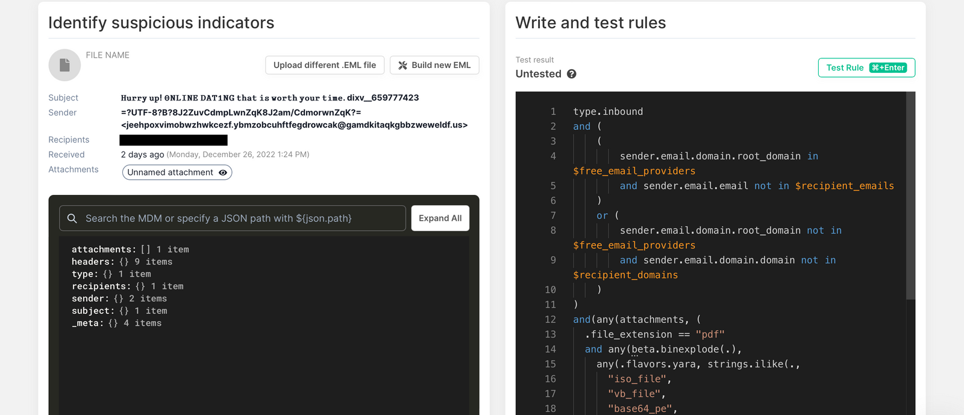
Sublime Security

Slide 14


"Free" platforms
Notes:
There are so many great tools out there that can be deployed to accomplish several different goals, but if you are leveraging several, managing each one individually can become cumbersome. This is where all-in-one platforms come in.

Slide 15
Tabletop Exercises
aka LARP-ing a very bad day at work
Notes:
What is a tabletop?
Create scenario of an attack
Gather ppl who would be involved in response
Play through how you would respond as a team
Can be as big or small as you want
A few ppl from technical team
Cross-team
Execs, Legal, Comms

Slide 16


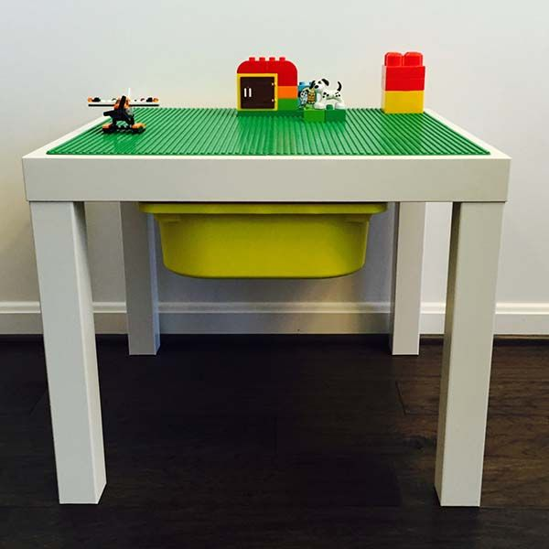



Tabletop Exercises
Start with scope
Think about the audience
Be conscious of tone
Resources
CISA Cybersecurity Scenarios
CIS Tabletop Exercises
@badthingsdaily on Twitter
Notes:
Not enough time in this talk to go through design specifics
Start with the end
What processes to test?
What is company most at risk for?
Think like a threat actor
Audience
Technical expertise
Roles during incident
Build facilitation questions and scenario info on those
Tone
People get nervous
In planning and during tabletop: Learning exercise
Resources
Aimed at bigger orgs w specialization
Smaller orgs everyone wears many hats
Institutional knowledge
Capture and cross-train

Slide 17

Buy-in from Leadership
Quantify the risk
Bring in other stakeholders
Show, don't tell
Notes:
Explain financial impacts of an incident
How these proactive measures will help
Or real world ex from peer orgs
Get other stakeholders involved
Compliance reqs – Legal or HR
How this maps to compliance frameworks
Or makes you look good to insurance
Show
Tabletop exercises
Illustrate how incidents progress
Why you need sec tools
Sec team got 3 new people in middle of TTX

Slide 18
Thanks!
Find us:
At the happy hour
On Twitter
@clari_explains
@r_stgermain
Find our slides:
https://github.com/rstgermain
Notes:
Thanks you all for coming!
You can find us at the happy hour, feel free to buy us a beer and ask some questions
On Twitter
Slides will be posted on github as well

